Slide 1


SCHOOL MANAGEMENT SYSTEM
Presented by
Sihab Bin Sarwar(2023-1-60-043)
Maksudul Hasan Limon(2023-1-60-045)
Redoanul Alam Mozumder (2023-1-60-046)
Nadim Srabon (2023-1-60-047)

Slide 2

CONTENTS
Introduction
Objectives
Functions
Output
Methodology
Implementation
Lackings
Future implementation
conclusion

Slide 3

INTRODUCTION
Welcome to our School Management System!! Our intuitive design and rich feature set make it simple to do administrative duties, boost communications, and organize your school. It is simple to add, view, search, amend, and delete records using the modules for managing students and teachers. A tool called Class Routine is included in the Academic module for effective scheduling.

Slide 4

OBJECTIVES
Efficient Student Management: Create a system that allows administrators to easily add, view, search, edit, and delete student records, providing a centralized database for managing student information.

Slide 5
OBJECTIVES
Teacher Management: Develop functionalities for administrators to add, view, search, edit, and delete teacher records, enabling efficient management of the school's teaching staff.

Slide 6
OBJECTIVES
Enhanced Academic Organization: Implement a Class Routine feature to help administrators schedule and manage classes effectively, ensuring a well-organized academic environment.

Slide 7
OBJECTIVES
System Security: Implement authentication mechanisms to ensure secure access to the system, protecting sensitive data and maintaining the privacy and integrity of student and teacher records.

Slide 8

FUNCTIONS
For executing this project we had to write and make various functions. These functions made this project
possible.

Slide 9

1.STUDENT MODULE
Add student [add_student_record()]
View all student record [viewAllStudentRecord()]
Edit student record [edit()]
Search student records [search_student_by_roll()]
Delete student record

Slide 10
2.TEACHERS MODULE & ACADEMIC
Add teacher [add_teacher_record()]
View all teachers record [viewAllTeacherRecord()]
Edit teacher record [edit_teacher_record()]
Search teacher records by [ID search_teacher_by_id()]
Delete teacher record
Routine [printClassRoutine()]

Slide 11

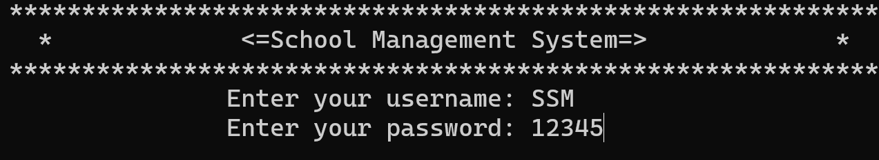
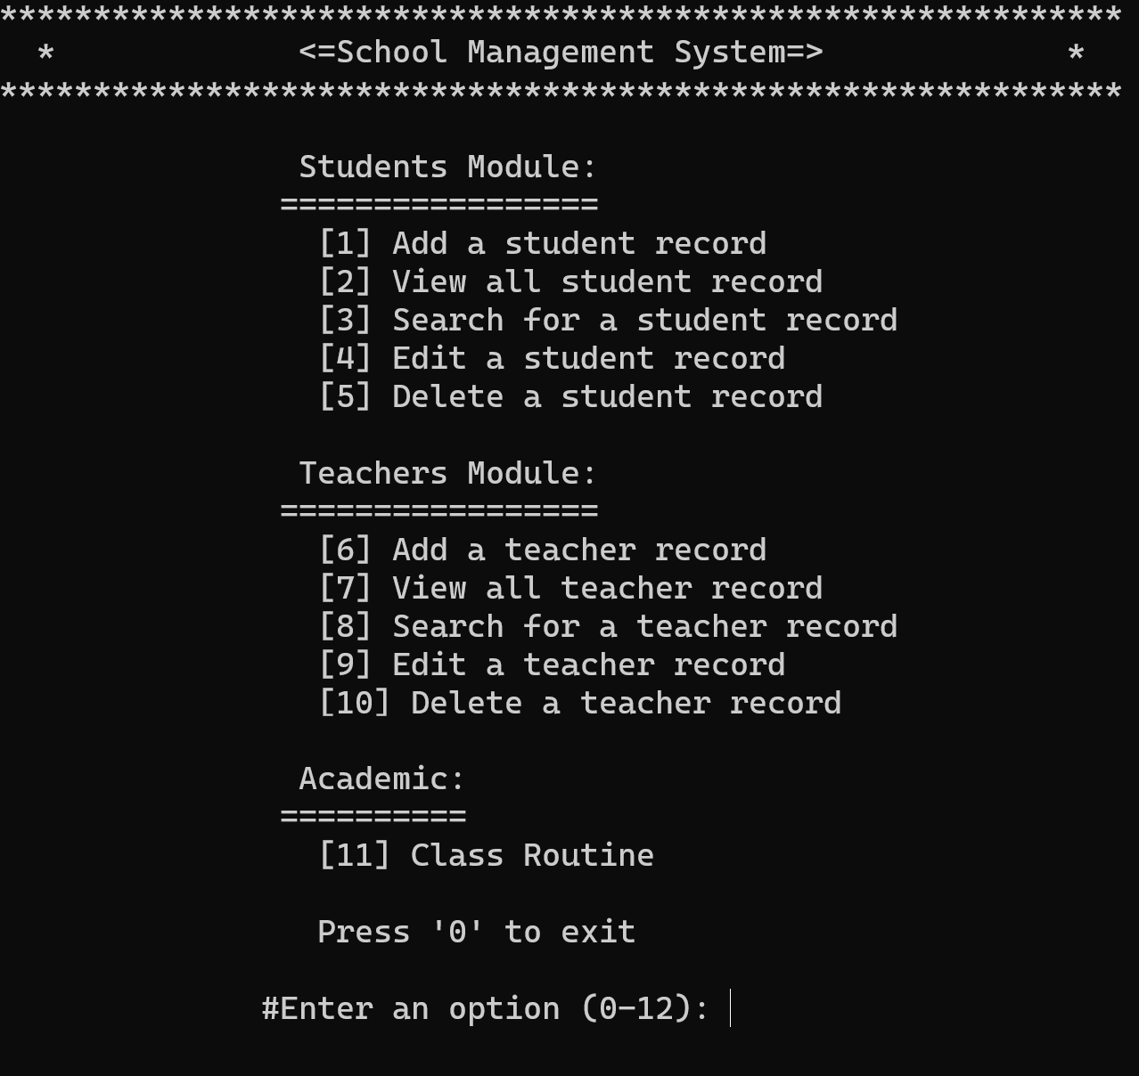
OUTPUT 1.AUTHENTICATION 2.MENU
When user enters username and password which will be preset, user will see this menu bar and he will be able to do what he wants among these options.

Slide 12
METHODOLOGY
System Design: Based on the gathered requirements, design the system architecture and database structure. Create detailed diagrams, such as entity-relationship diagrams and flowcharts, to visualize the system components and their interactions.
Technology Selection: Choose the appropriate technologies and tools for developing the School Management System in C. Consider factors such as compatibility, performance, security, and ease of use.
User Interface Design: Design an intuitive and user-friendly interface that aligns with the requirements. Create mockups or prototypes to gather feedback from users and make necessary refinements before proceeding to the development phase.
Database Development: Develop the database structure according to the designed architecture. Implement tables, relationships, and data validation rules to ensure data integrity and security.
Testing and Quality Assurance: Conduct rigorous testing of the system to identify and fix any bugs or issues. Perform functional testing, integration testing, and user acceptance testing to ensure that the system meets all the requirements.
Academic Module Development: Develop the Class Routine feature, allowing administrators to schedule and manage classes efficiently. Incorporate features for handling timetable conflicts and generating reports as required.
Authentication and Security: Implement authentication mechanisms, such as username and password-based login, to ensure secure access to the system. Apply appropriate security measures to protect sensitive data and prevent unauthorized access.
Core Functionality Implementation: Start developing the core functionalities of the system, such as adding, viewing, searching, editing, and deleting student and teacher records. Implement necessary validation checks and error handling mechanisms.

Slide 13

LACKINGS
Our program does not include a feature for changing the user's password. Currently, it can only be modified within the source code.
Our program's alignment and appearance can be further improved for a more visually appealing and cohesive presentation.
The source code lacks input validation functionality, which is important for ensuring that user inputs are valid and appropriate.

Slide 14


FUTURE IMPLEMENTATIONS
Implementing input validation to ensure users enter accurate and valid data.
Improving error handling by incorporating suitable error messages and exception handling.
Enhancing search functionality by enabling advanced options like searching by member Name and 🆔.
Adding sorting features to arrange the project list based on different attributes.
Implementing user authentication and access control to restrict unauthorized users from performing certain operations.

Slide 15

CONCLUSION
In conclusion, by reducing administrative processes, fostering effective communication, and assuring data integrity, the School Management Project in C has succeeded in meeting its goals though it has some lackings. It included user authentication, comprehensive search and sorting capabilities, input validation, error handling, and a user-friendly interface. This project serves as an example of how programming may be used to improve school management systems and boost overall effectiveness.

